Slide 1
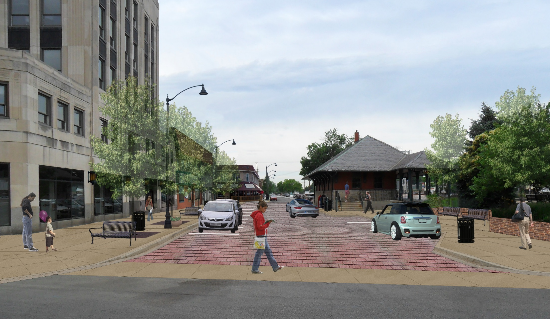


Public Meeting Berwyn Depot District Streetscape Project
LAKOTA
www.thelakotagroup.com

Slide 2
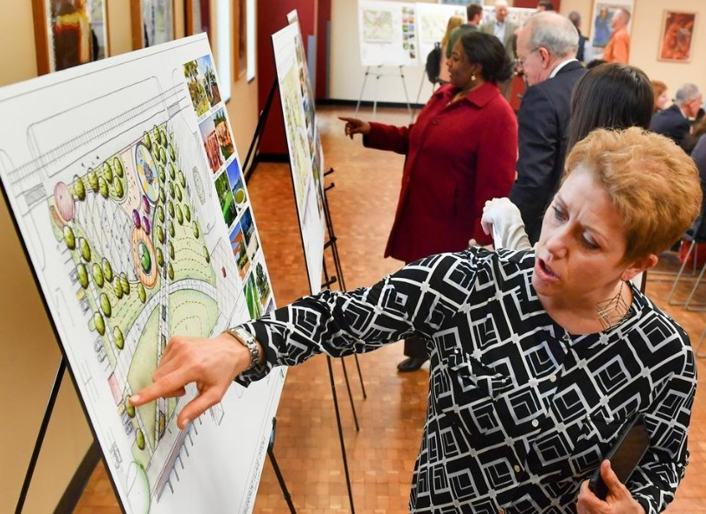
Public Meeting Format
Project Presentation
General Questions
Project Stations
Project Specific Questions
Public Comment Period

Slide 3
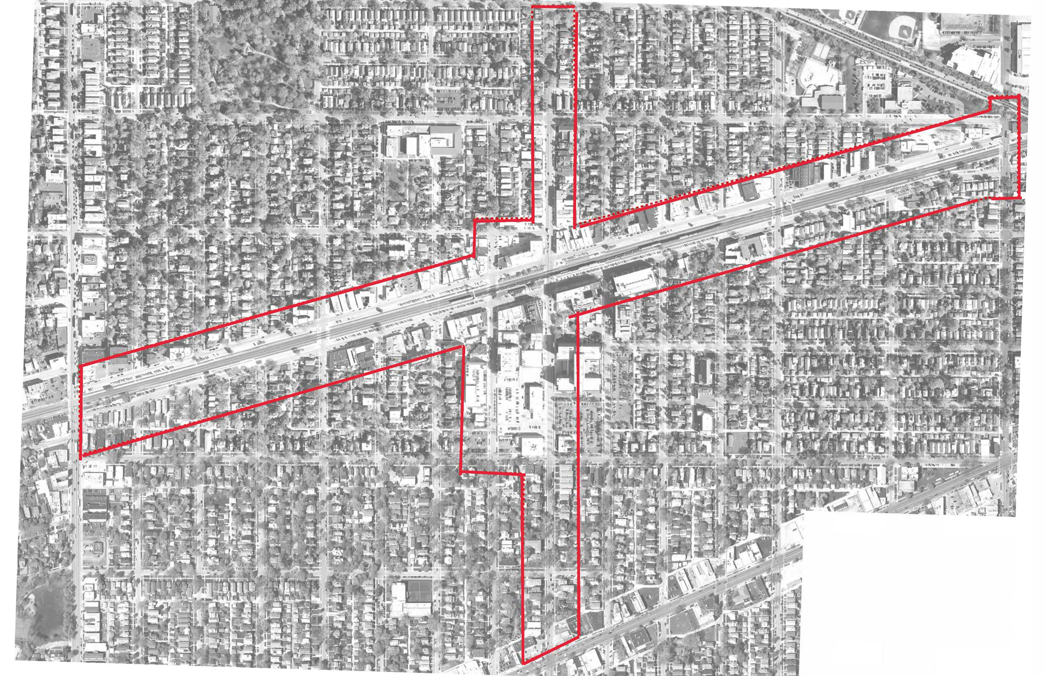
Project Location
30th St.
31st St.
BNSF Railroad
Ridgeland Ave.
Harlem Ave.
Stanley Ave.
Windsor Ave.
34th St.
Grove Ave.
Oak Park Ave.
Ogden Ave.

Slide 4
Project Goals
Utility Project (Sewer and Water)
Roadway Improvement
Pedestrian Access and Accommodations
Bike Lanes and Racks
Parking Improvements
New Lighting
Green Infrastructure
Streetscape Amenities
Improved Drainage

Slide 5
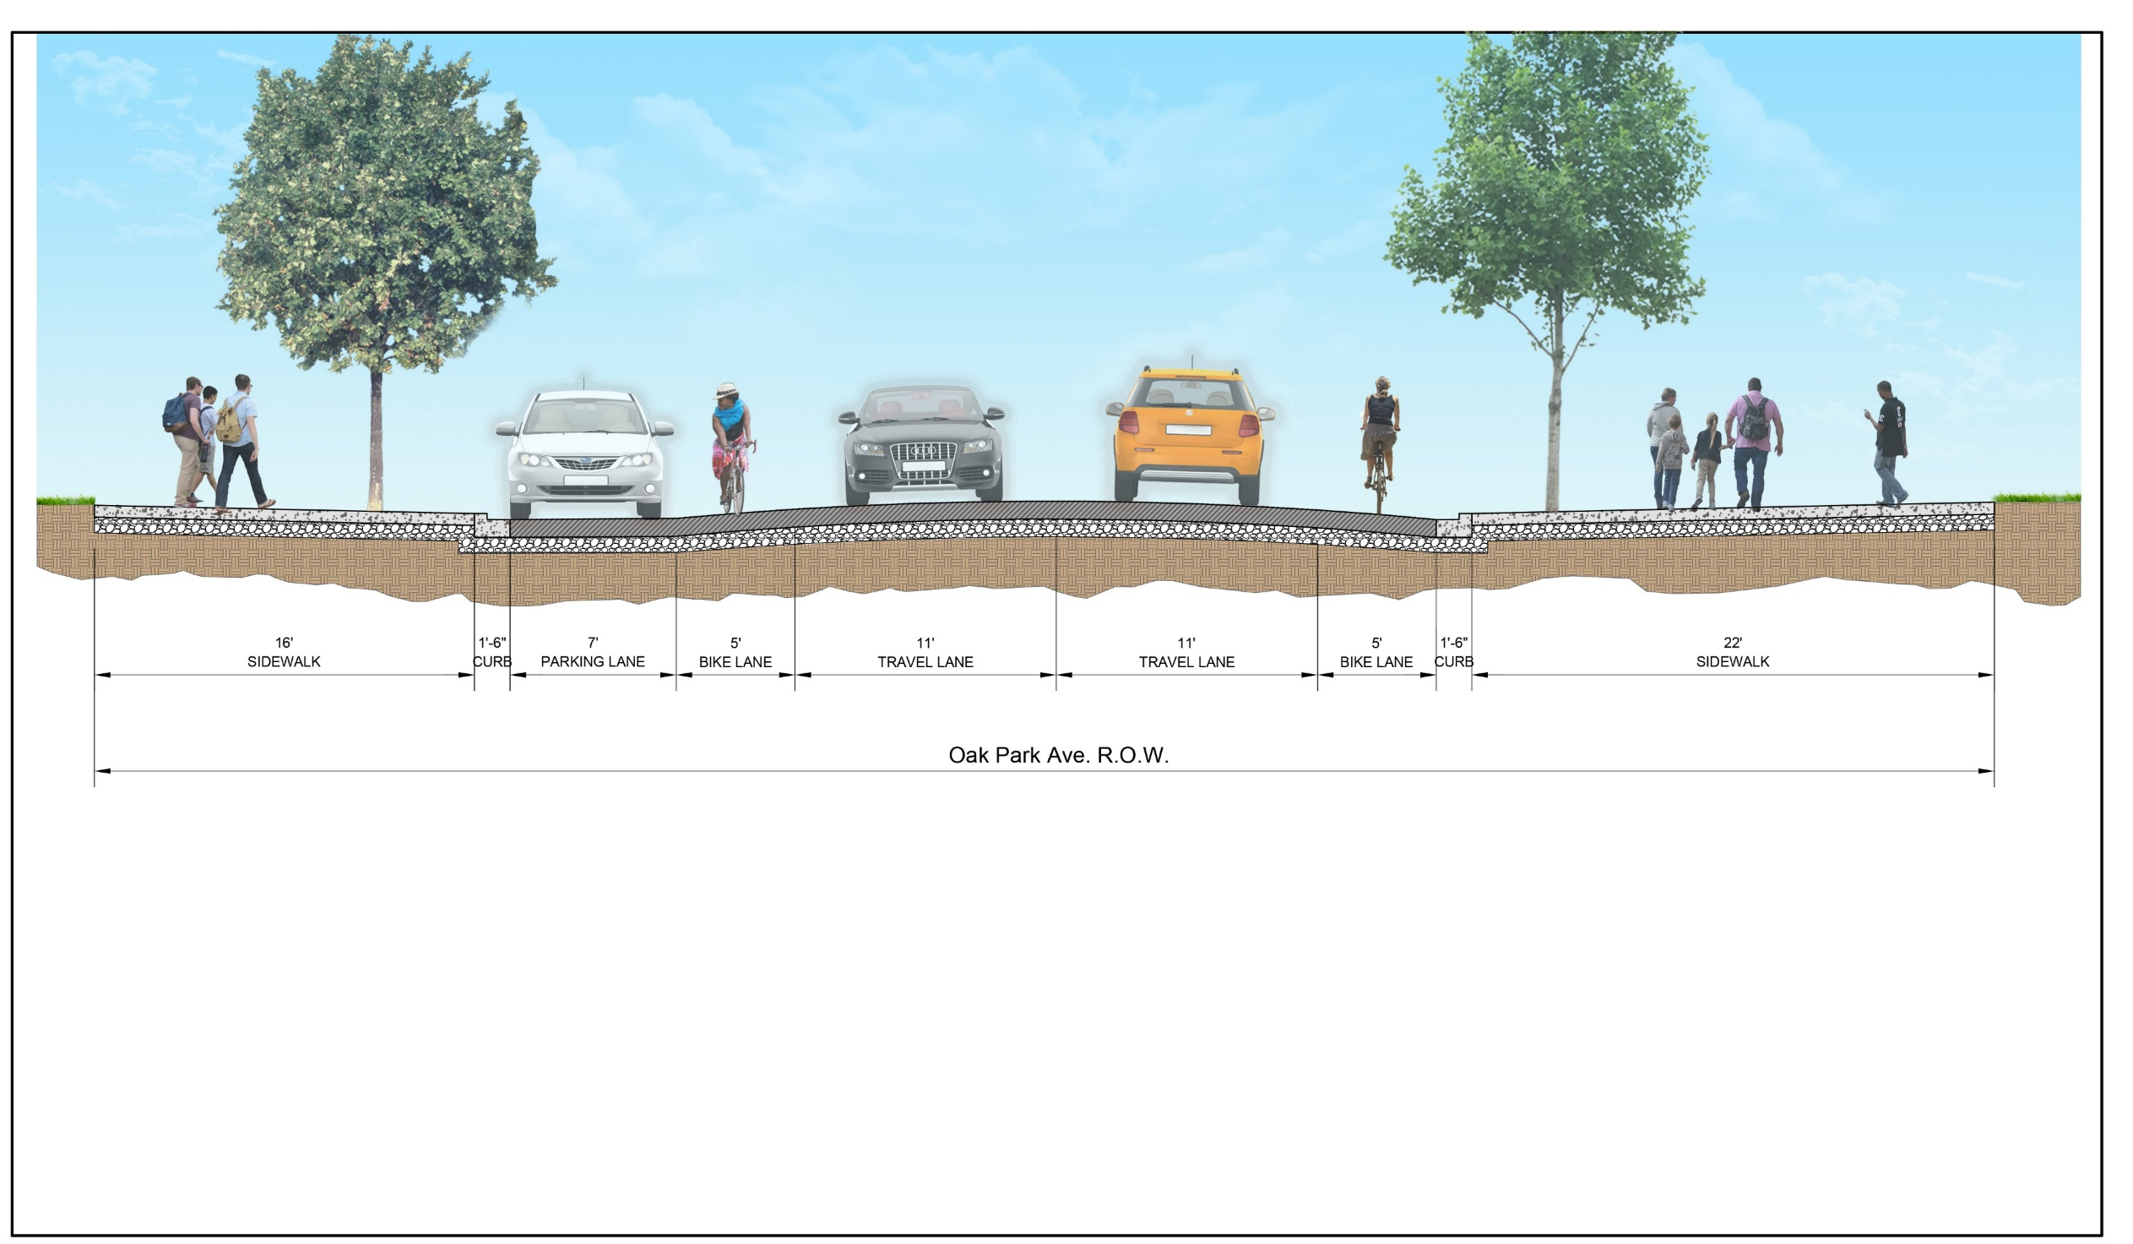
Oak Park Avenue Cross Section

Slide 6
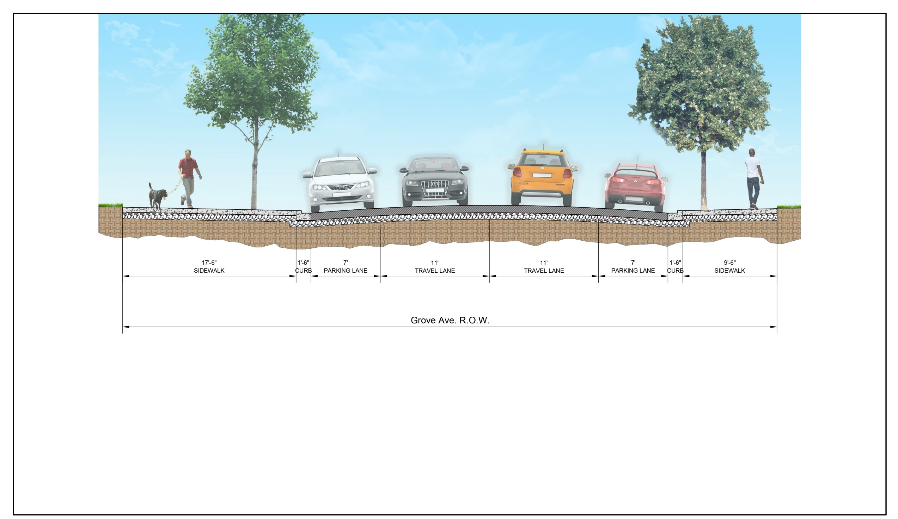
Grove Avenue Cross Section

Slide 7
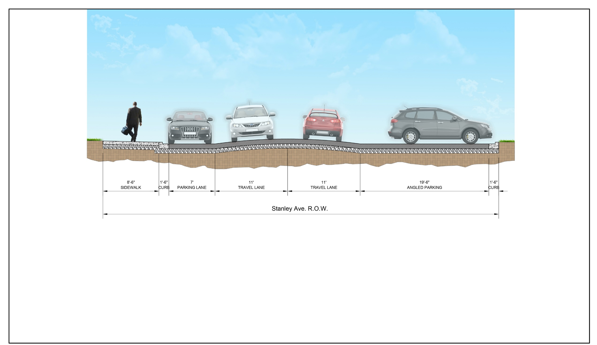
Stanley Avenue Cross Section

Slide 8
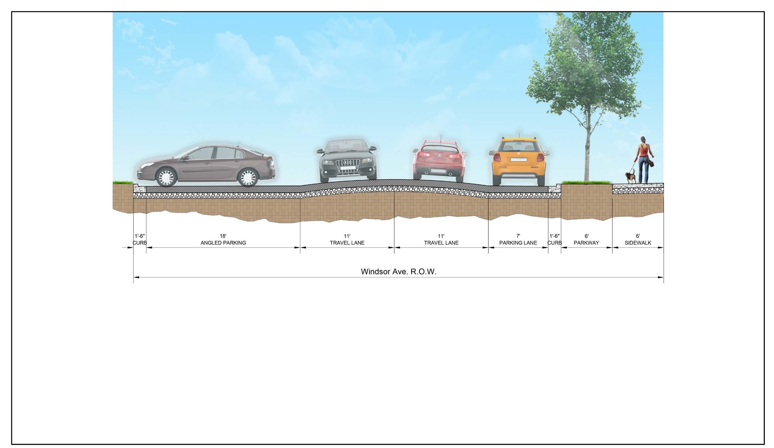
Windsor Avenue Cross Section

Slide 9
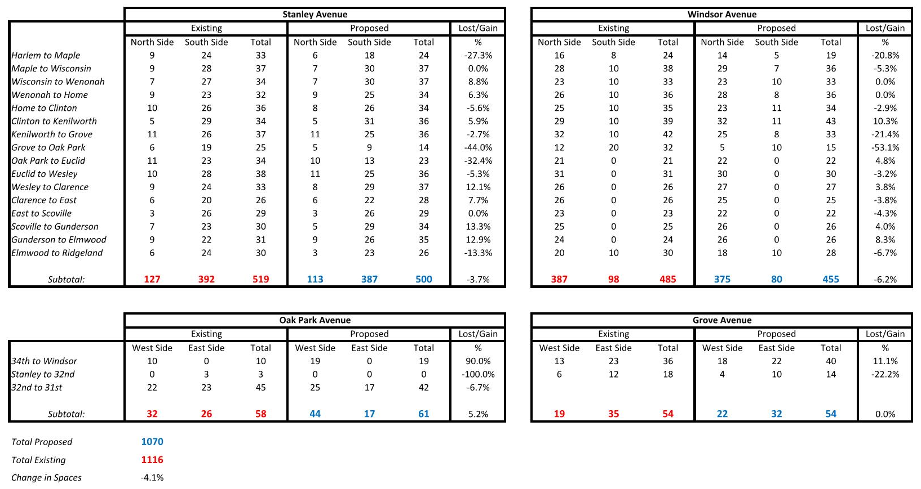
Parking Summary

Slide 10
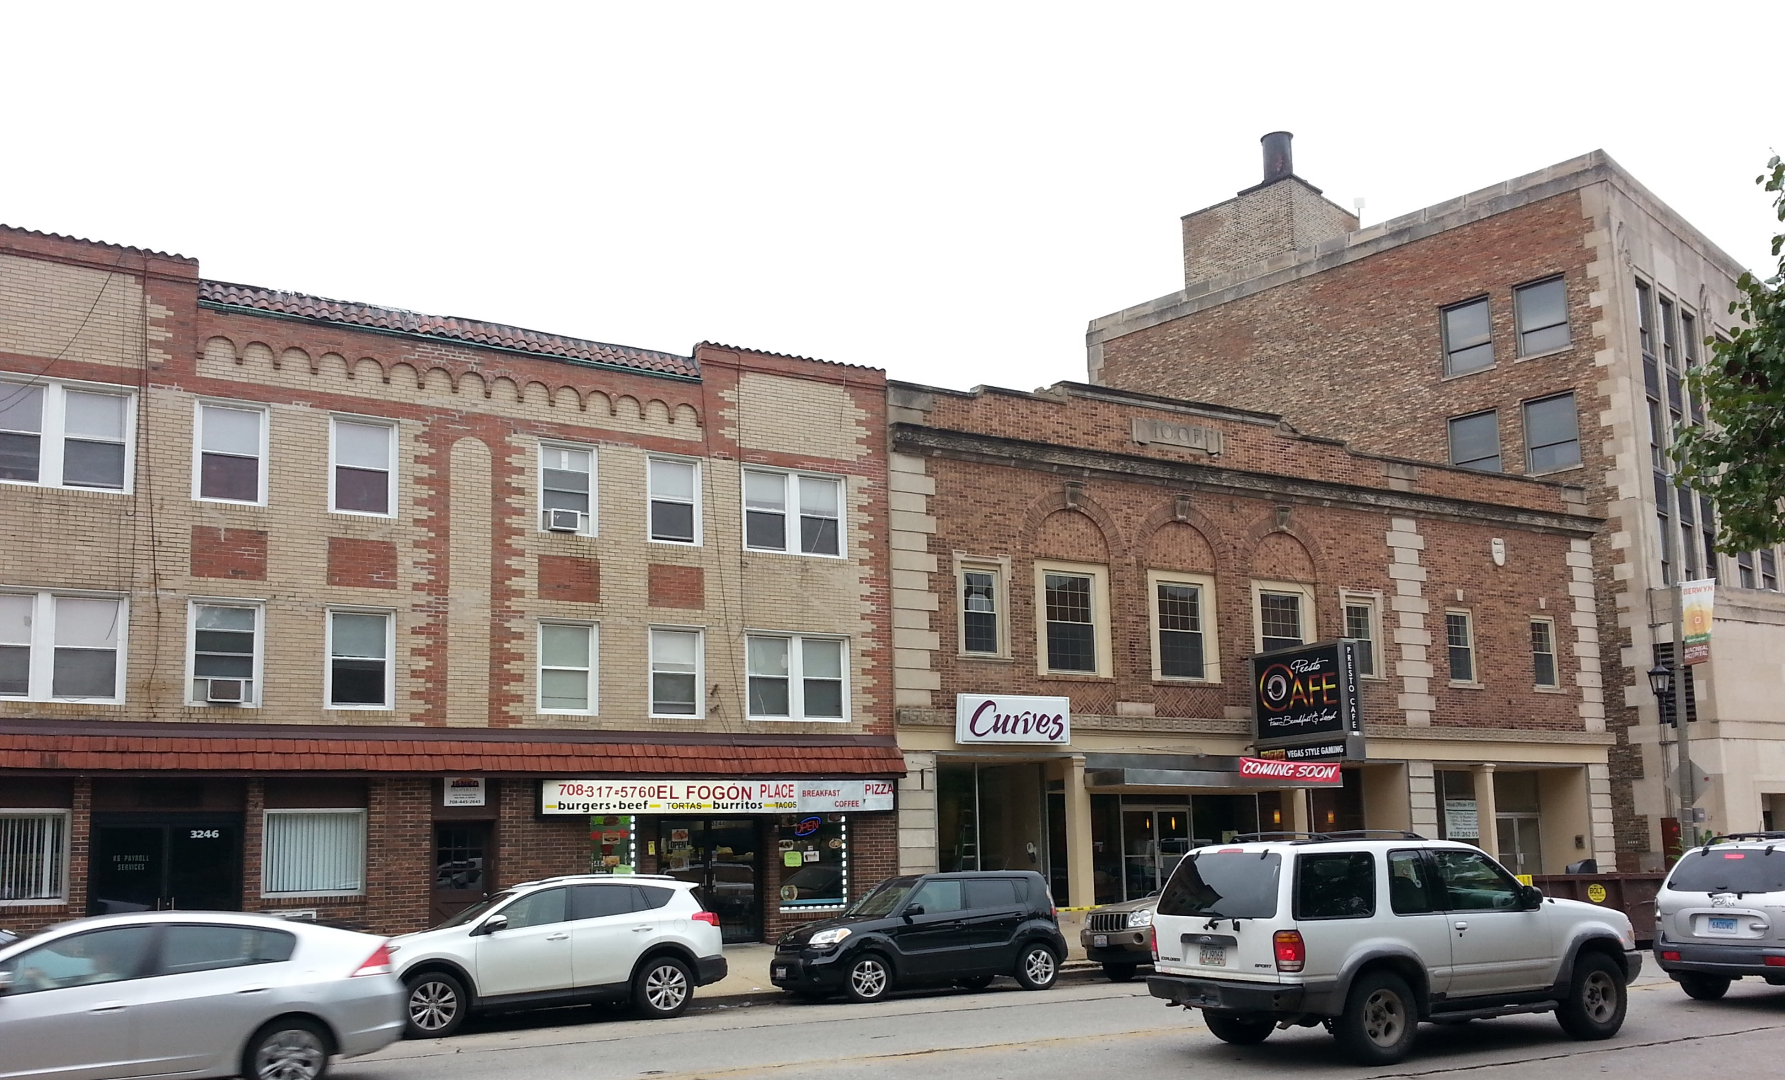
Streetscape Amenities
LAKOTA
www.thelakotagroup.com

Slide 11
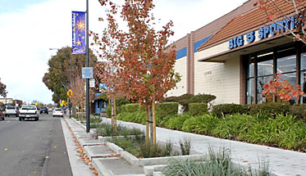
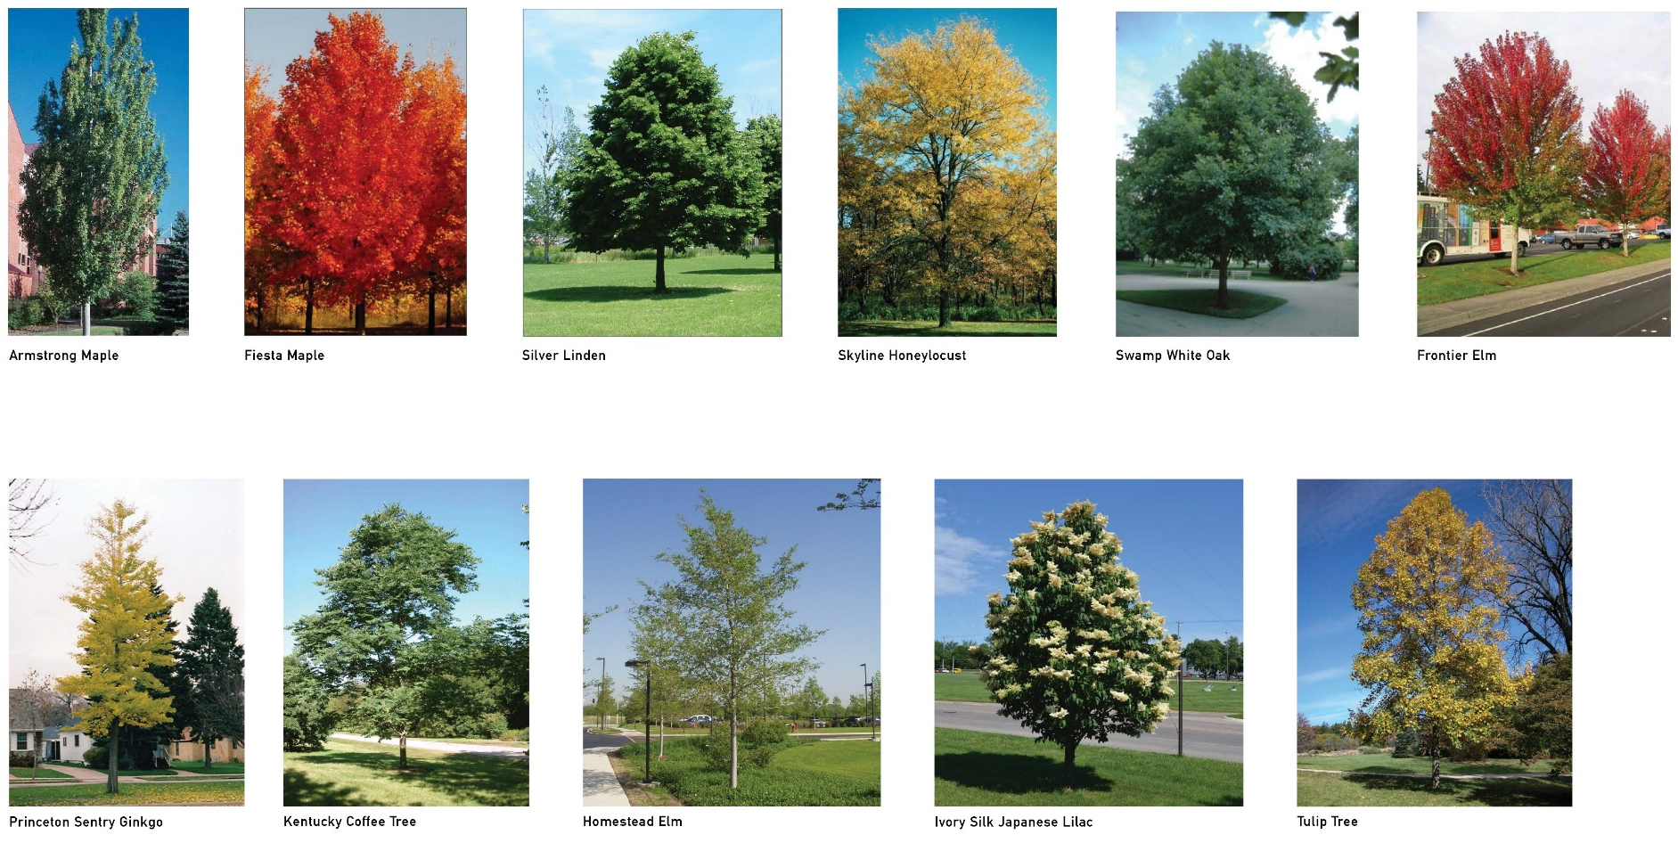
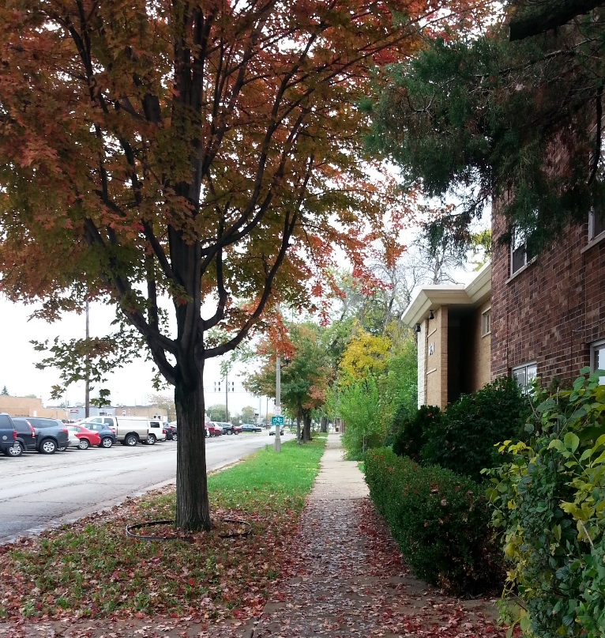
Street Trees
Maintain existing, healthy, mature trees when possible
Trees in grates to maintain open sidewalks for pedestrian circulation and outdoor dining opportunities

Slide 12
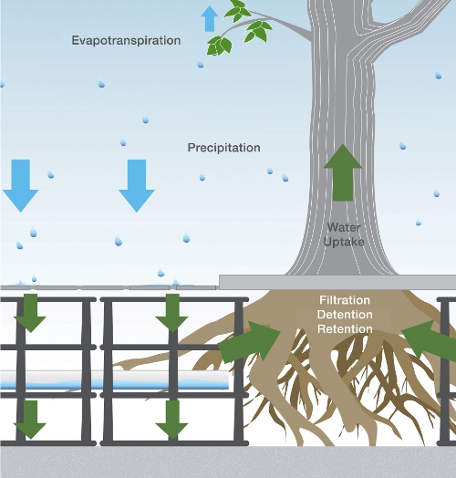
Silva Cells
Use of silva cells with tree grates to promote healthier trees and manage stormwater

Slide 13
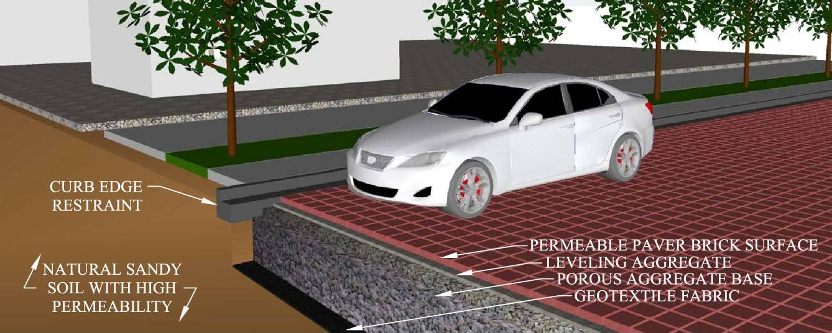
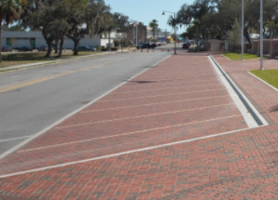
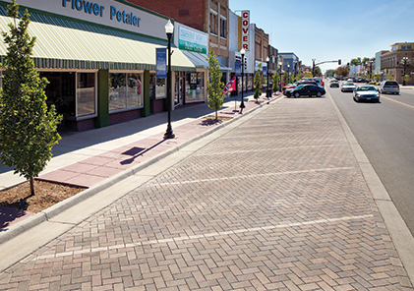
Pavers
Permeable pavers in parking areas to manage stormwater
Decorative pavers on Windsor Ave. in the Metra Station area to add character and highlight the downtown hub

Slide 14
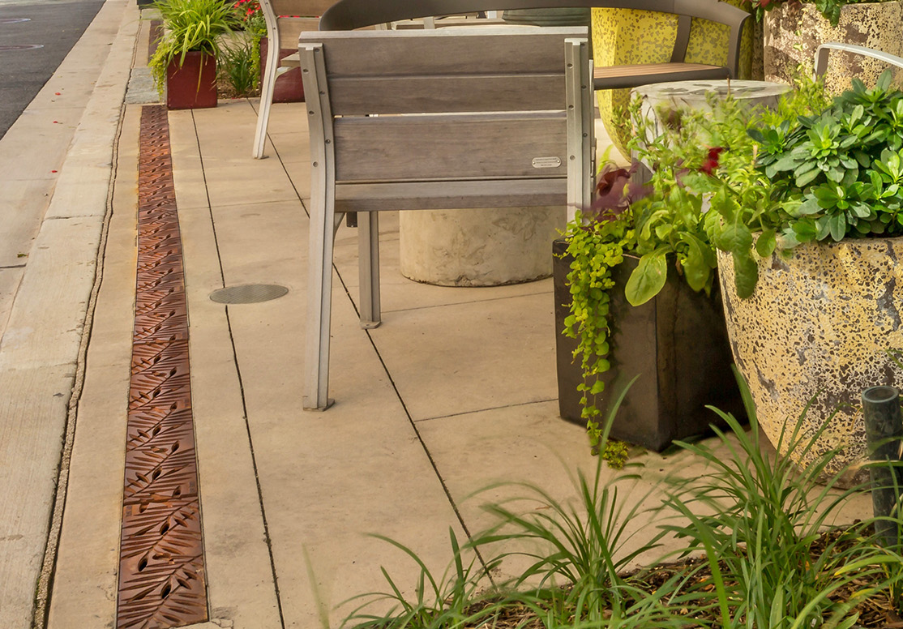
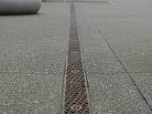
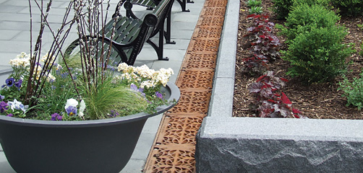
Trench Drains
Complements Silva and permeable paver stormwater solutions

Slide 15
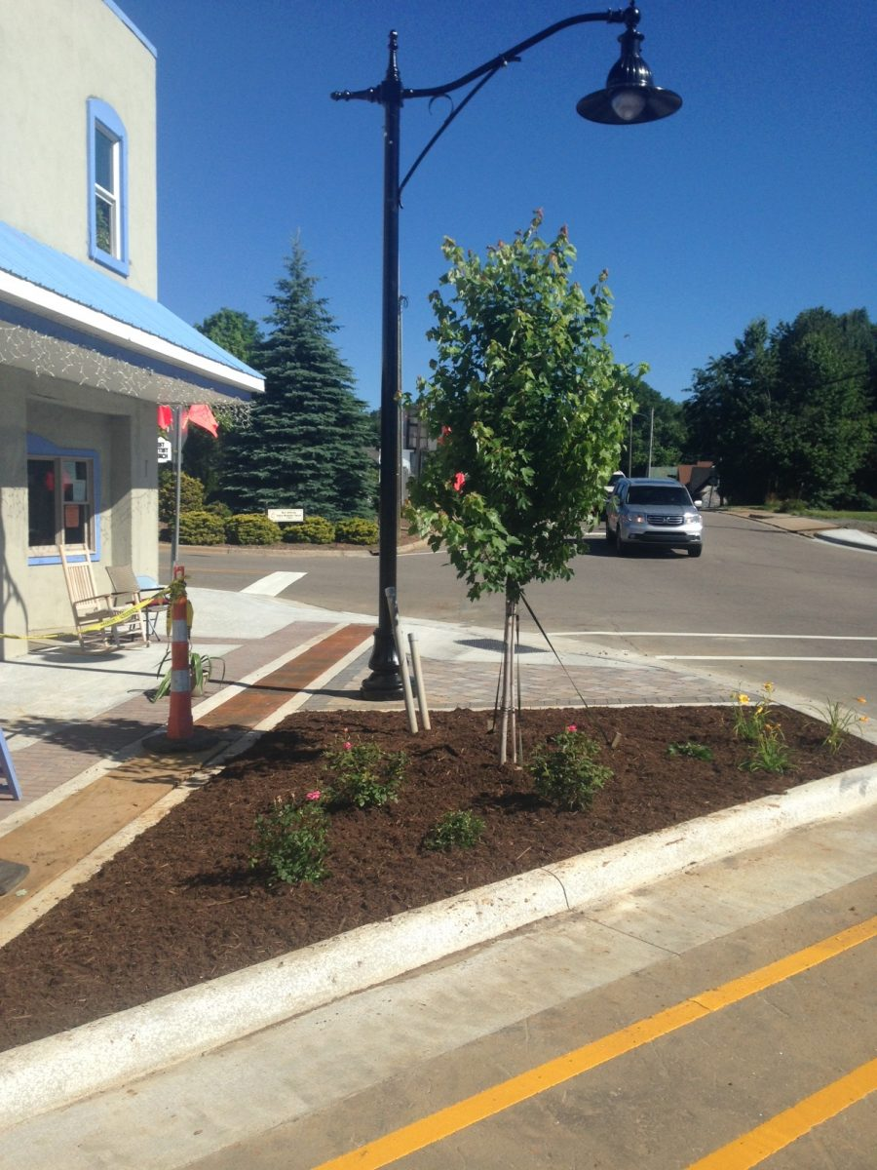

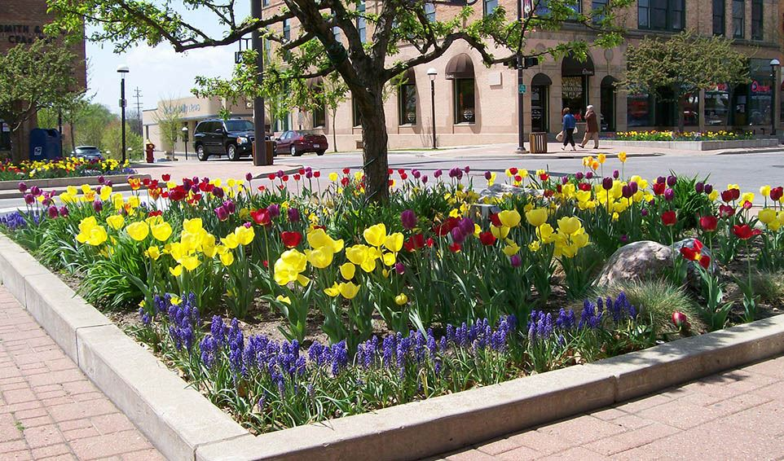
Planters
Trees in planters where space allows adds color and interest in the form of shrubs and perennials
Movable Concrete Planters

Slide 16
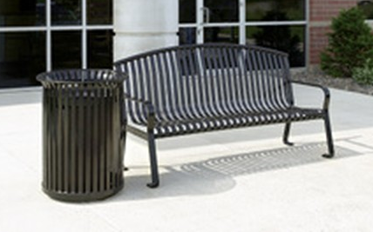
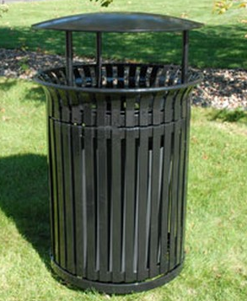
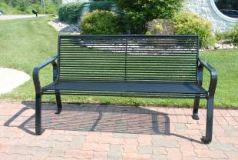
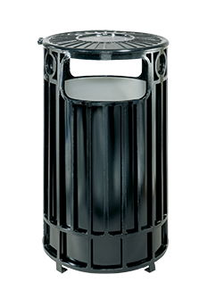
Site Furniture
Benches
Trash Receptacles

Slide 17
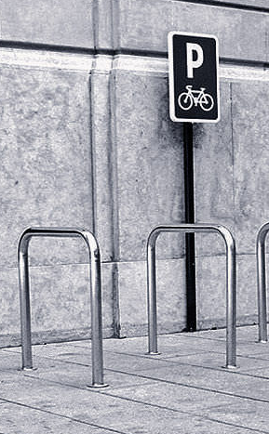
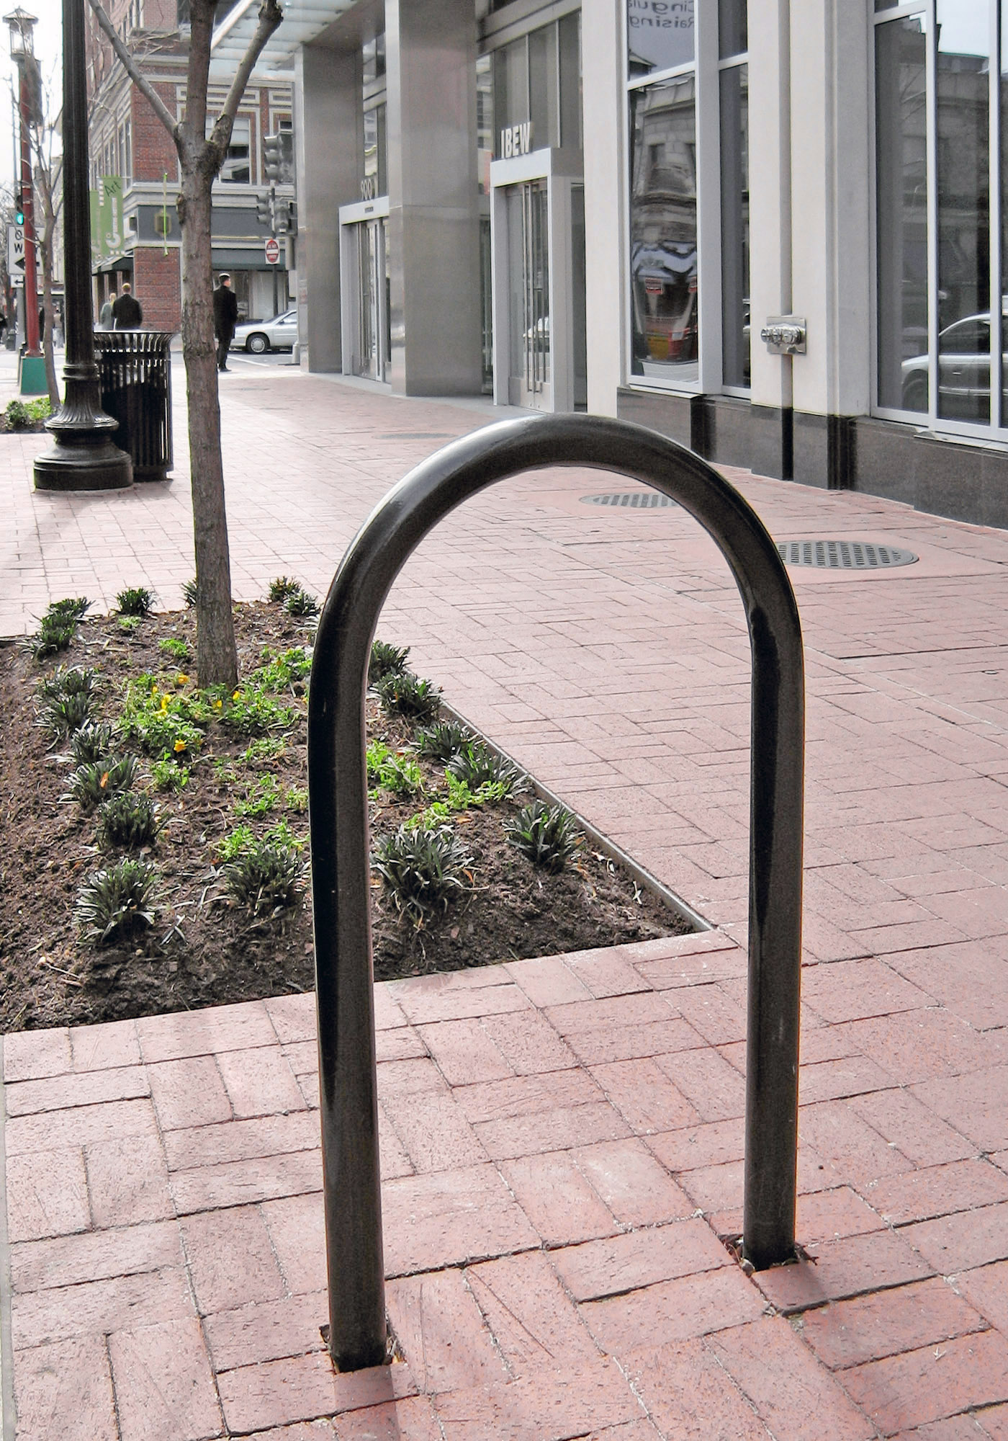
Site Furniture
Bike Racks

Slide 18
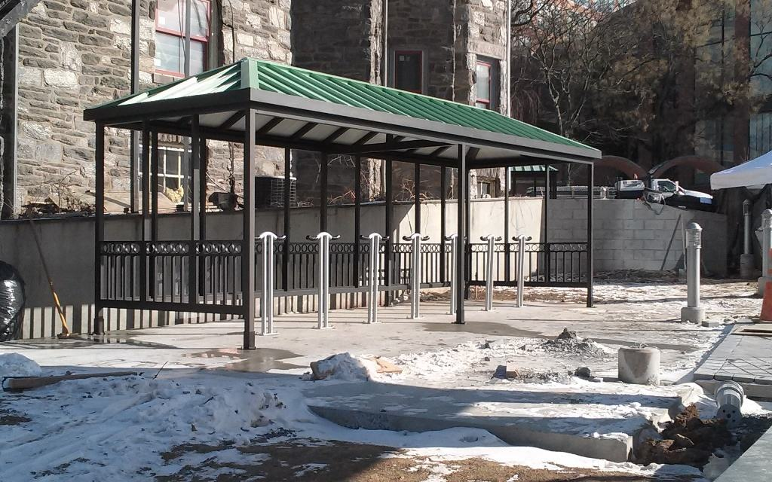
Bike Shelter
Two at Harlem Station
Two at Berwyn Station
One at LaVergne Station

Slide 19
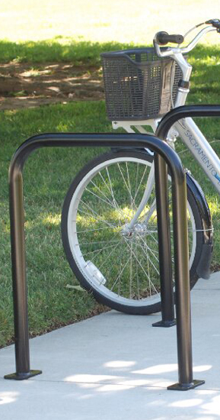
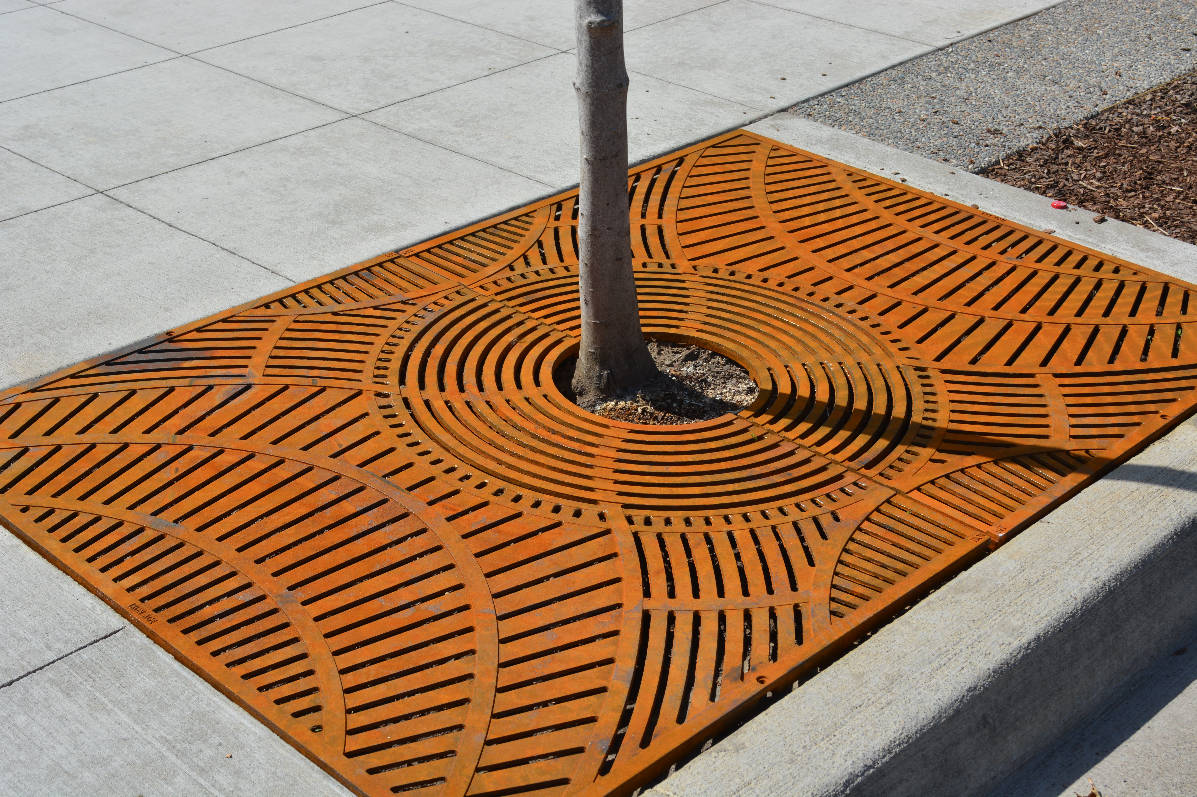
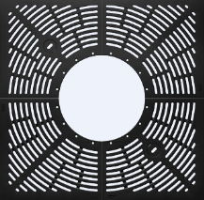
Tree Grates

Slide 20
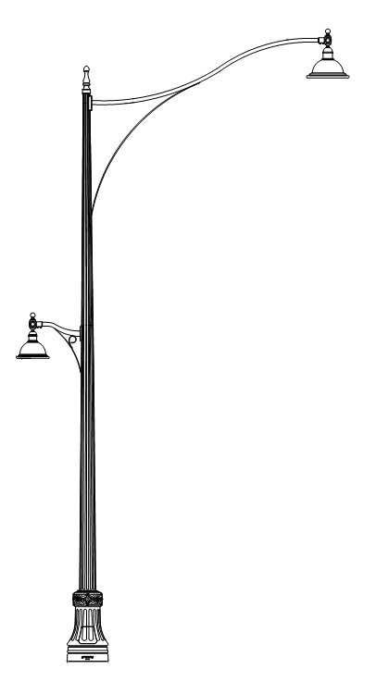
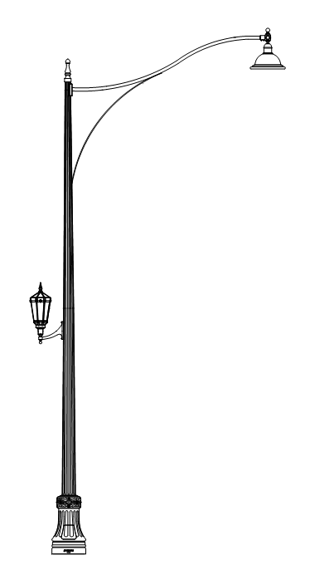
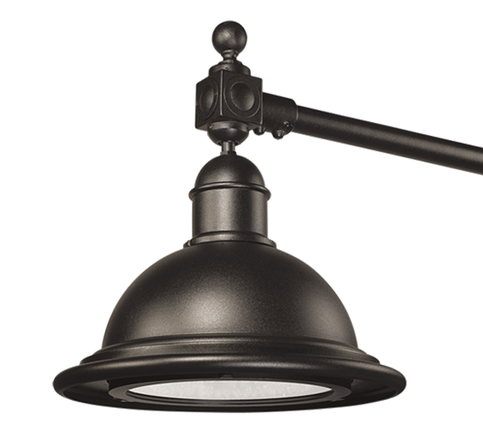
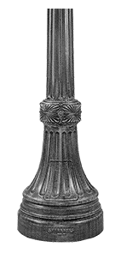
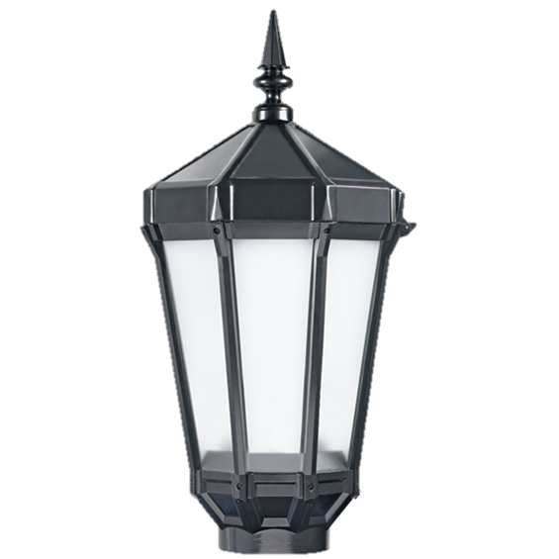
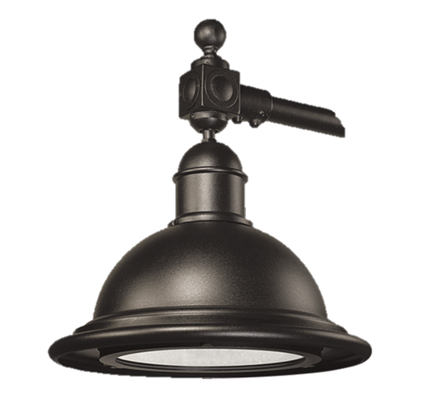
Street Lighting
Street Lights
Pedestrian Lights
Alternating poles with flags and banners
30’ pole
16’ high pedestrian fixture
Outlets in poles for festivals and holiday lighting

Slide 21
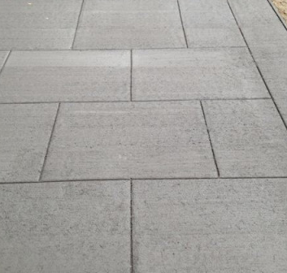
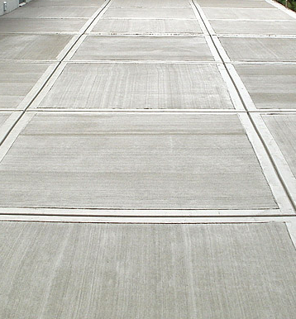
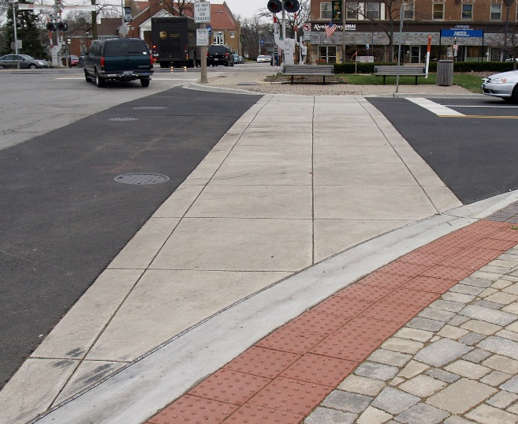
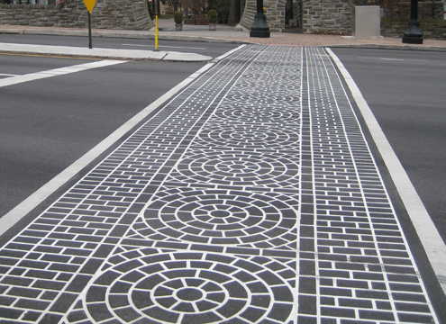
Paving
Scored Concrete Sidewalks
Thermoplastic Crosswalks
Scored Concrete Crosswalk

Slide 22
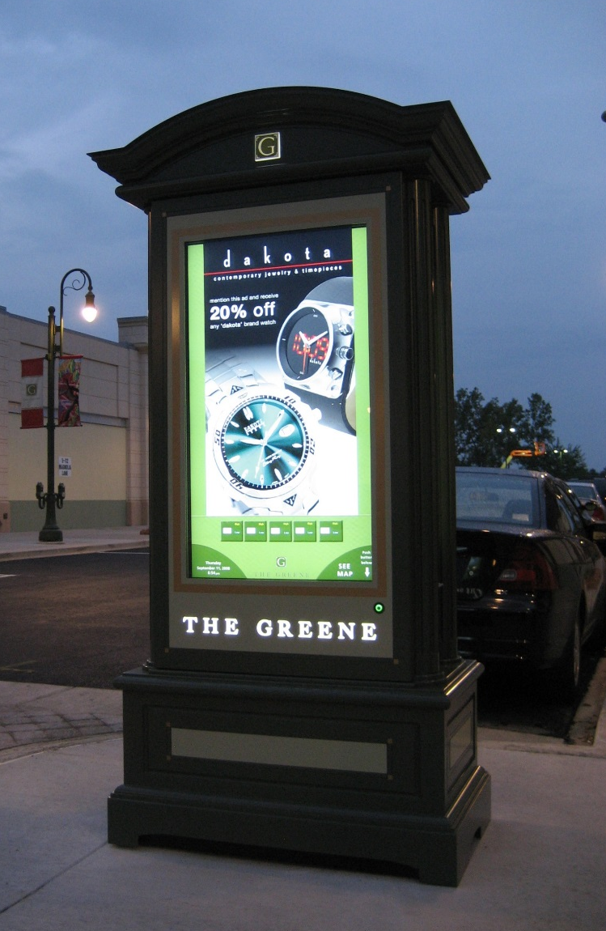
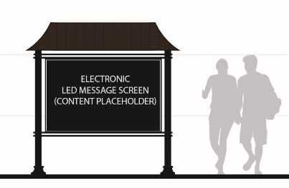
Message Board
Alternative to static sign
Downtown location

Slide 23
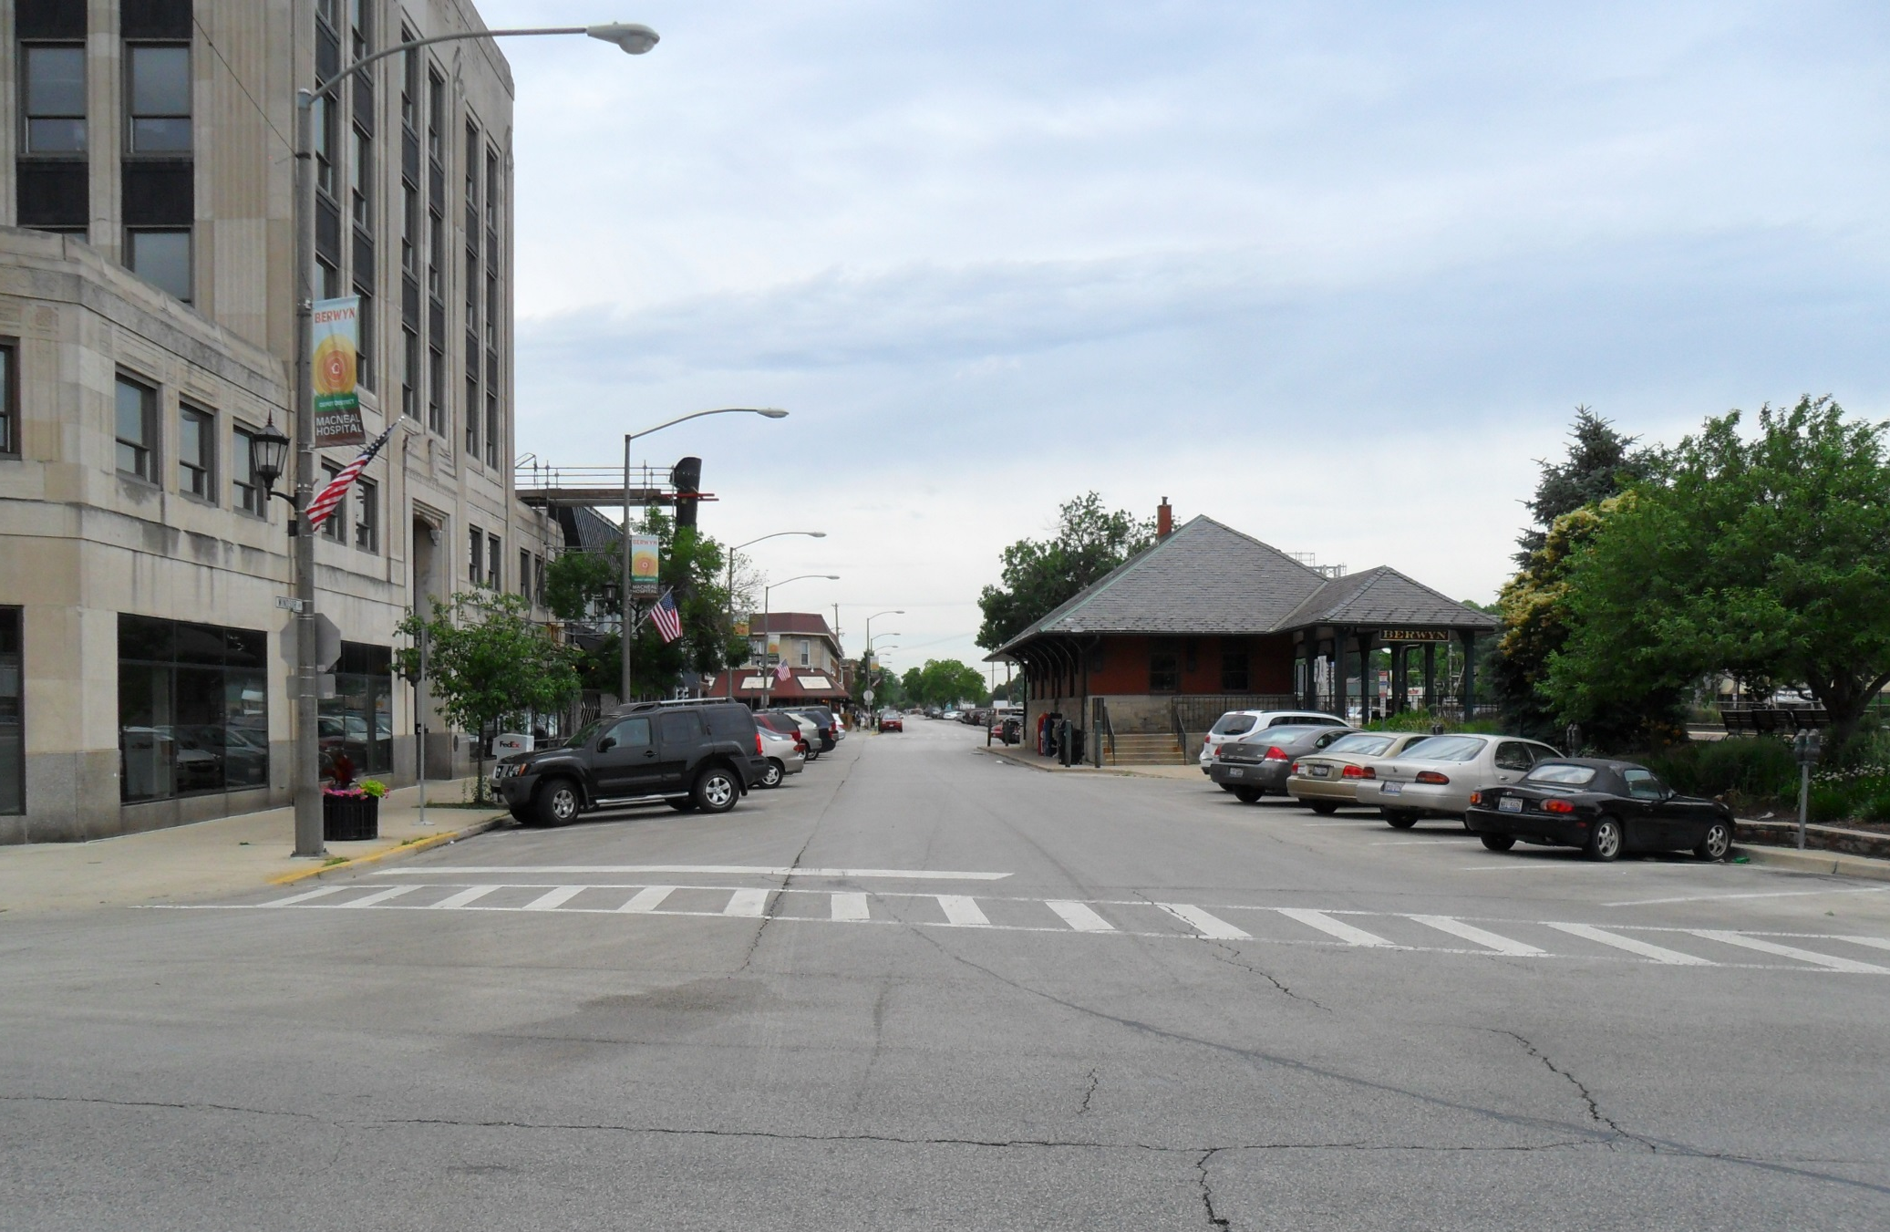
Plaza Street – Existing Conditions

Slide 24
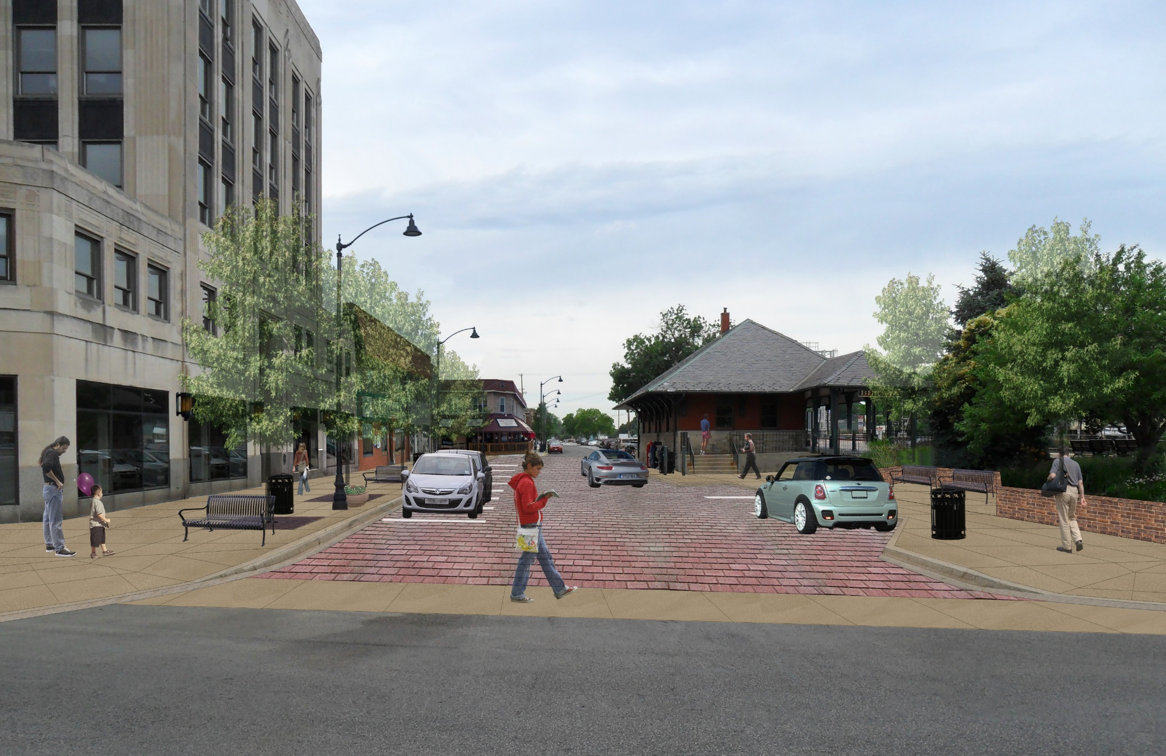
Plaza Street – Proposed Improvements

Slide 25
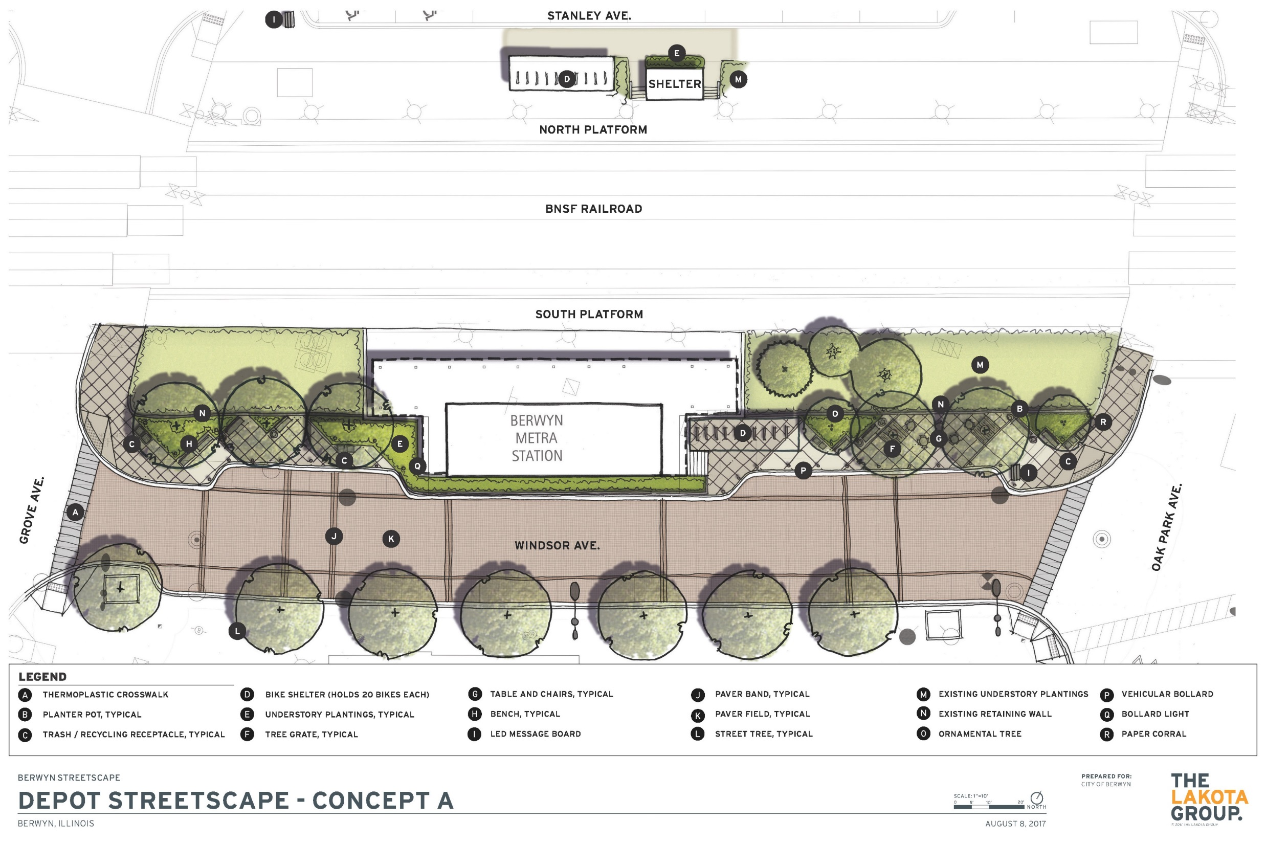

Slide 26
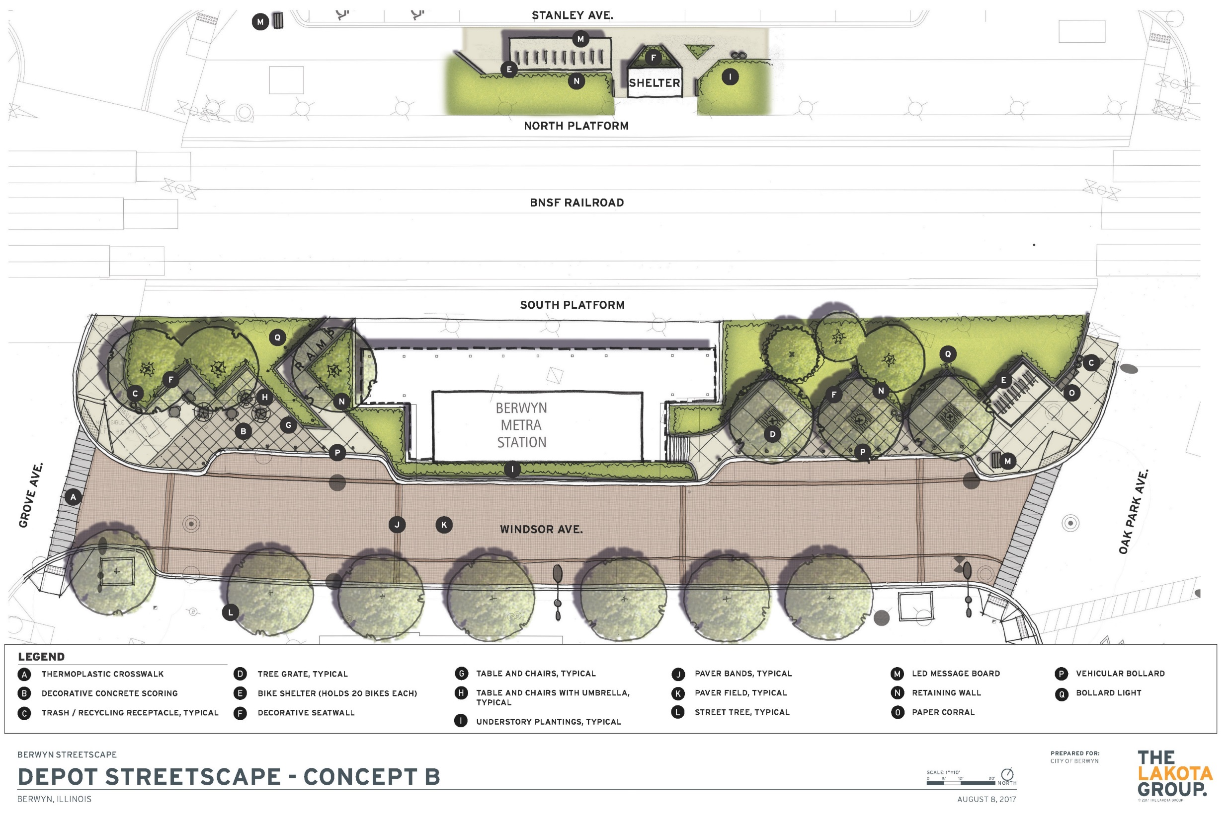

Slide 27
Project Status
Phase I Project Development Report Submitted
Geometry Approved by IDOT and BNSF
Environmental Clearances Received
Design Exceptions
Public Meeting

Slide 28
Next Steps
Refine Project Cost
Submit Final Project Development Report
Obtain Phase I Design Approval
Prepare Phase II Bid Documents
Construction

